Slide 1

MySQL II

Slide 2
Objectives
Introduction to SQL
SQL Statements
Normalization

Slide 3
Introduction to SQL
SQL is a standard language for accessing and manipulating databases.
What is SQL?
SQL stands for Structured Query Language
SQL lets you access and manipulate databases
SQL became a standard of the American National Standards Institute (ANSI) in 1986, and of the International Organization for Standardization (ISO) in 1987
To build a web site that shows data from a database, you will need
An RDBMS database program (i.e. MS Access, SQL Server, MySQL)
To use a server-side scripting language, like PHP or ASP
To use SQL to get the data you want
To use HTML / CSS to style the page

Slide 4


SQL SELECT
The SELECT statement is used to select data from a database.
The data returned is stored in a result table, called the result-set.
Syntax:
column1, column2, ... are the field names of the table you want to select data from. If you want to select all the fields available in the table, use the following syntax

Slide 5

SQL SELECT DISTINCT
The SELECT DISTINCT statement is used to return only distinct (different) values.
Inside a table, a column often contains many duplicate values; and sometimes you only want to list the different (distinct) values.
The SELECT DISTINCT statement is used to return only distinct (different) values.
Syntax

Slide 6


SQL WHERE Clause
The WHERE clause is used to filter records.
The WHERE clause is used to extract only those records that fulfill a specified condition.
The WHERE clause is not only used in SELECT statement, it is also used in UPDATE, DELETE statement, etc.
Syntax
Example

Slide 7
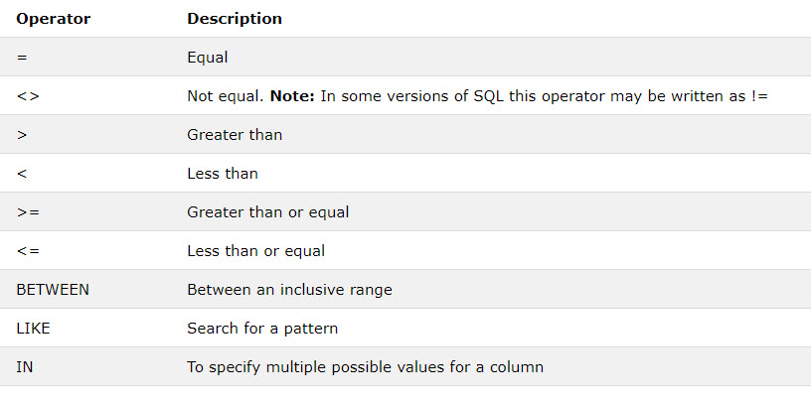
WHERE Clause
The following operators can be used in the WHERE clause

Slide 8
AND, OR and NOT Operators
The WHERE clause can be combined with AND, OR, and NOT operators.
The AND and OR operators are used to filter records based on more than one condition:
The AND operator displays a record if all the conditions separated by AND is TRUE.
The OR operator displays a record if any of the conditions separated by OR is TRUE.
The NOT operator displays a record if the condition(s) is NOT TRUE.

Slide 9



AND, OR and NOT Operators
AND Syntax
OR Syntax
NOT Syntax

Slide 10

SQL ORDER BY
The ORDER BY keyword is used to sort the result-set in ascending or descending order.
The ORDER BY keyword sorts the records in ascending order by default. To sort the records in descending order, use the DESC keyword.
Syntax

Slide 11
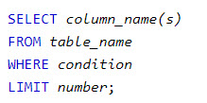
SELECT TOP Clause
The SELECT TOP clause is used to specify the number of records to return.
The SELECT TOP clause is useful on large tables with thousands of records. Returning a large number of records can impact on performance.
Note: Not all database systems support the SELECT TOP clause. MySQL supports the LIMIT clause to select a limited number of records, while Oracle uses ROWNUM.
MySQL Syntax

Slide 12

SQL LIKE Operator
The LIKE operator is used in a WHERE clause to search for a specified pattern in a column.
There are two wildcards used in conjunction with the LIKE operator:
% - The percent sign represents zero, one, or multiple characters
_ - The underscore represents a single character
You can also combine any number of conditions using AND or OR operators.
Syntax

Slide 13
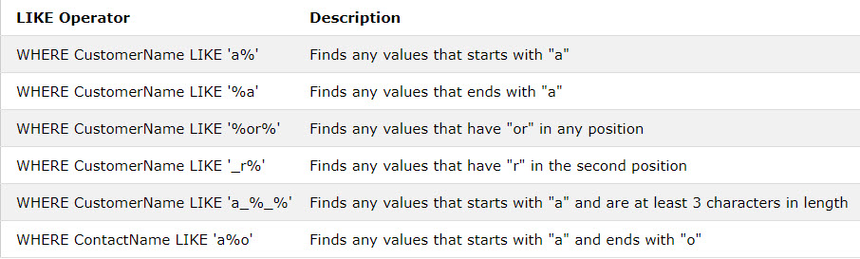
Example
Here are some examples showing different LIKE operators with '%' and '_' wildcards:

Slide 14


SQL MIN() and MAX()
The MIN() function returns the smallest value of the selected column.
The MAX() function returns the largest value of the selected column.
MIN() Syntax
MAX() Syntax

Slide 15



COUNT(),AVG(),SUM()
The COUNT() function returns the number of rows that matches a specified criteria.
The AVG() function returns the average value of a numeric column.
The SUM() function returns the total sum of a numeric column.
Syntax

Slide 16


SQL IN Operator
The IN operator allows you to specify multiple values in a WHERE clause.
The IN operator is a shorthand for multiple OR conditions.
Syntax
Example

Slide 17


BETWEEN Operator
The BETWEEN operator selects values within a given range. The values can be numbers, text, or dates.
The BETWEEN operator is inclusive: begin and end values are included.
Syntax
Example

Slide 18


SQL Aliases
SQL aliases are used to give a table, or a column in a table, a temporary name.
Aliases are often used to make column names more readable.
An alias only exists for the duration of the query.
Note: It requires double quotation marks or square brackets if the alias name contains spaces
Syntax
Example

Slide 19

SQL NULL Values
A field with a NULL value is a field with no value.
If a field in a table is optional, it is possible to insert a new record or update a record without adding a value to this field. Then, the field will be saved with a NULL value.
It is very important to understand that a NULL value is different from a zero value or a field that contains spaces. A field with a NULL value is one that has been left blank during record creation
It is not possible to test for NULL values with comparison operators, such as =, <, or <>.
We will have to use the IS NULL and IS NOT NULL operators instead.
Syntax

Slide 20
SQL Data Types
A data type defines what kind of value a column can hold: integer data, character data, monetary data, date and time data, binary strings, and so on.
Each column in a database table is required to have a name and a data type.
An SQL developer must decide what type of data that will be stored inside each column when creating a table.
The data type is a guideline for SQL to understand what type of data is expected inside of each column, and it also identifies how SQL will interact with the stored data.
Data types might have different names in different database. And even if the name is the same, the size and other details may be different

Slide 21
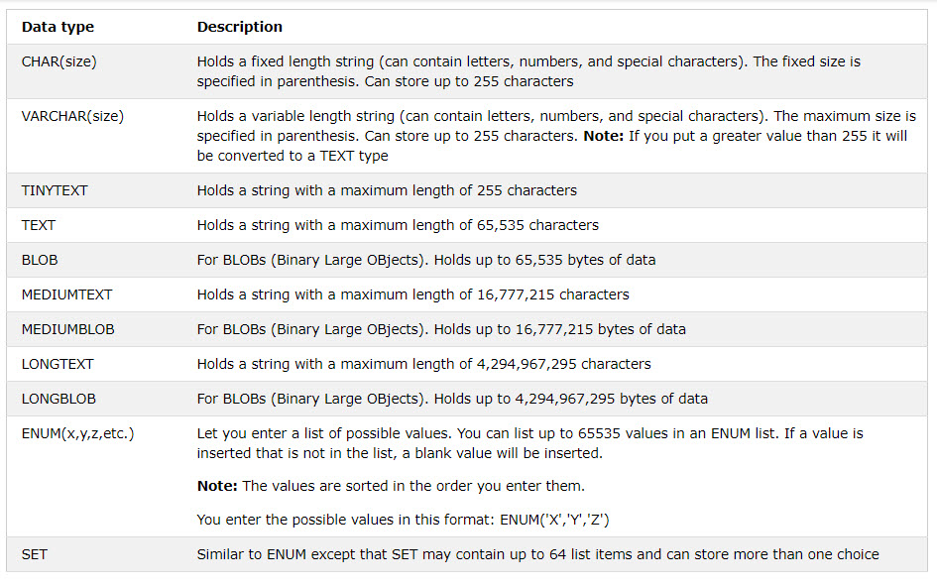
MySQL Data Types
In MySQL there are three main data types: text, number, and date.
Text data types

Slide 22
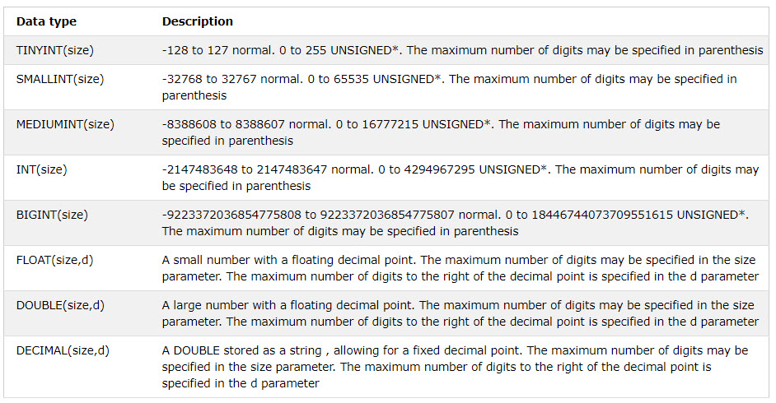
MySQL Data Types
Number data types

Slide 23
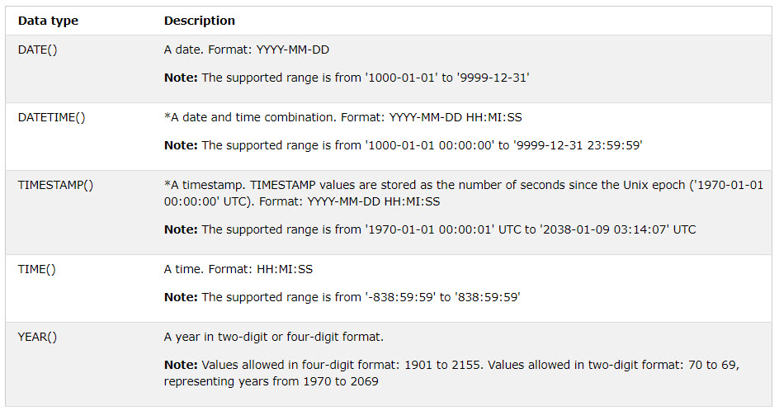
MySQL Data Types
Date data types

Slide 24
Demo
Teacher demo SQL statements for students

Slide 25
Understanding Data Redundancy
Redundancy:
Increases the time involved in updating, adding, and deleting data.
Increases the utilization of disk space and hence, disk I/O increases.
Redundancy can, therefore, lead to:
Insertion, modification, and deletion of data, which may cause inconsistencies.
Errors, which are more likely to occur when facts are repeated.
Unnecessary utilization of extra disk space.

Slide 26
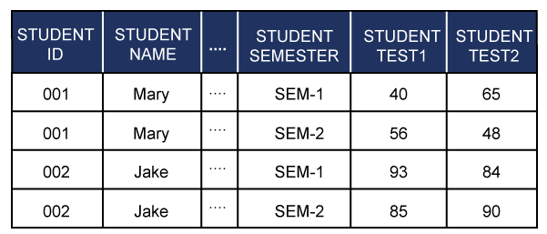
Understanding Data Redundancy
The STUDENT table contains the values for each attribute, as shown in the following diagram
The details of the students, such as STUDENTID and STUDENTNAME are repeated while recording marks of different semesters.

Slide 27
Definition of Normalization
Normalization:
Is a method of breaking down complex table structures into simple table structures by using certain rules.
Has the following benefits:
It helps in maintaining data integrity.
It helps in simplifying the structure of tables, therefore, making a database more compact.
It helps in reducing the null values, which reduces the complexity of data operations.

Slide 28
Definition of Normalization
Some rules that should be followed to achieve a good database design are:
Each table should have an identifier.
Each table should store data for a single type of entity.
Columns that accept NULL values should be avoided.
The repetition of values or columns should be avoided.

Slide 29
Definition of Normalization
Normalization results in the formation of tables that satisfy certain normal forms.
The normal forms are used to remove various types of abnormalities and inconsistencies from the database.
The most important and widely used normal forms are:
First Normal Form (1NF)
Second Normal Form (2NF)
Third Normal Form (3NF)
Boyce-Codd Normal Form (BCNF)

Slide 30
Definition of Normalization
First Normal Form (1NF):
A table is said to be in 1NF when each cell of the table contains precisely one value.
The guidelines for converting a table into 1NF are:
Place the related data values in a table. Further, define similar data values with the column name.
There should be no repeating group in the table.
Every table must have a unique primary key.

Slide 31
Definition of Normalization
Second Normal Form (2NF):
A table is said to be in 2NF when:
It is in the 1NF, and
No partial dependency exists between non-key attributes and key attributes.
The guidelines for converting a table into 2NF are:
Find and remove attributes that are functionally dependent on only a part of the key and not on the whole key. Place them in a different table.
Group the remaining attributes.

Slide 32
Definition of Normalization
Third Normal Form (3NF):
A relation is said to be in 3NF if and only if:
It is in 2NF, and
No transitive (indirect) dependency exists between non-key attributes and key attributes.
The guidelines for converting a table into 3NF are:
Find and remove non-key attributes that are functionally dependent on attributes that are not the primary key. Place them in a different table.
Group the remaining attributes.

Slide 33
Definition of Normalization
Boyce-Codd Normal Form (BCNF):
The original definition of 3NF was not sufficient in some situations. It was not satisfactory for the tables:
That had multiple candidate keys.
Where the multiple candidate keys were composite.
Where the multiple candidate keys overlapped (had at least one attribute in common).
The guidelines for converting a table into BCNF are:
Find and remove the overlapping candidate keys. Place the part of the candidate key and the attribute it is functionally dependent on, in a different table.
Group the remaining items into a table.

Slide 34
Summary
Introduction to SQL
SQL Statements
Normalization

